Slide 1
OOP
Install Visual Studio 2010

Slide 2

Double click on “vc_web.exe”
(double click to install)

Slide 3
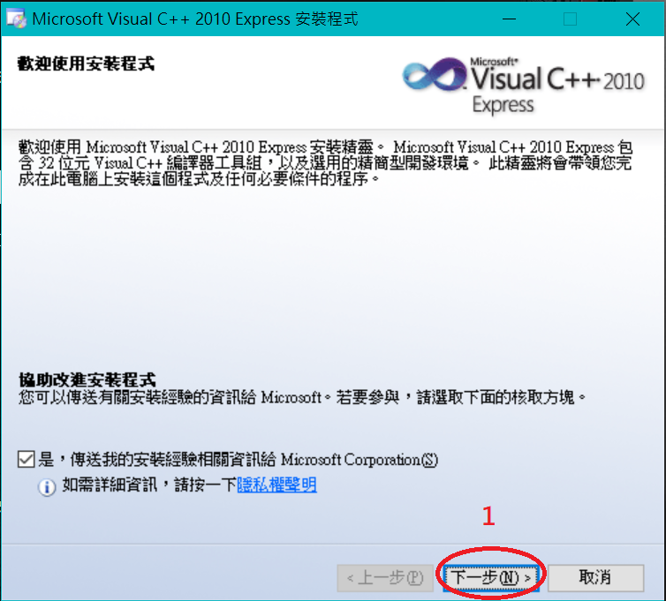
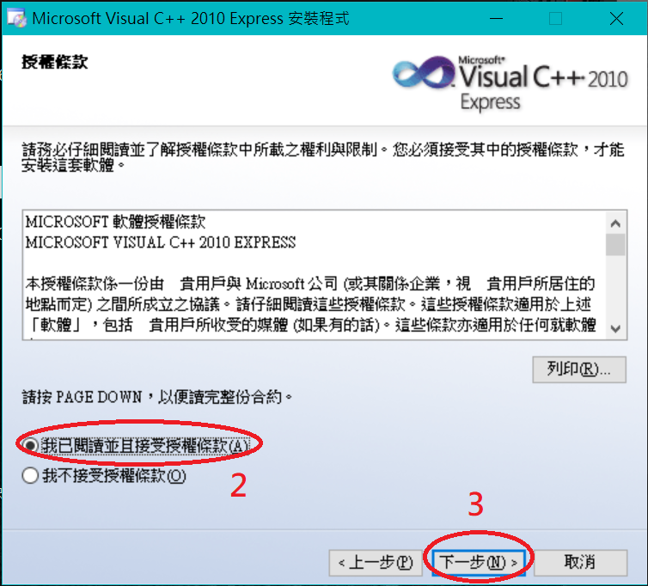
Install

Slide 4
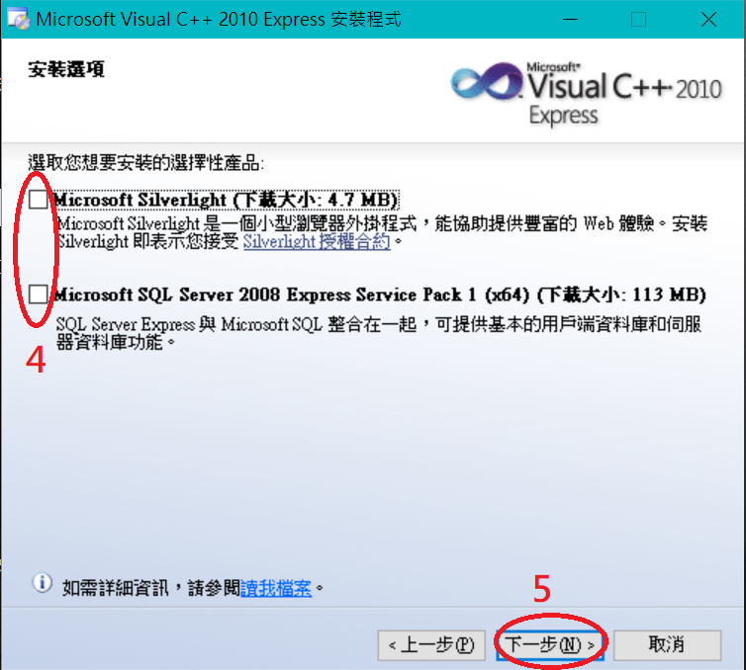

Slide 5
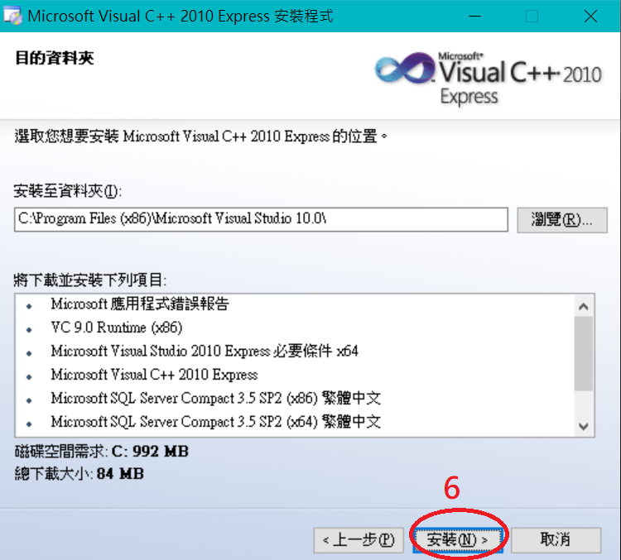

Slide 6
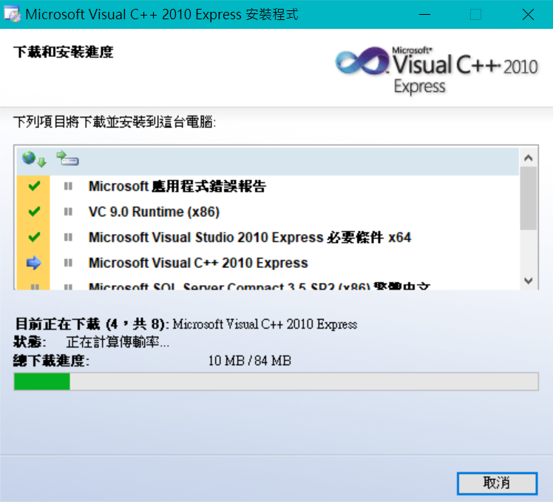
(Waiting for installation)

Slide 7
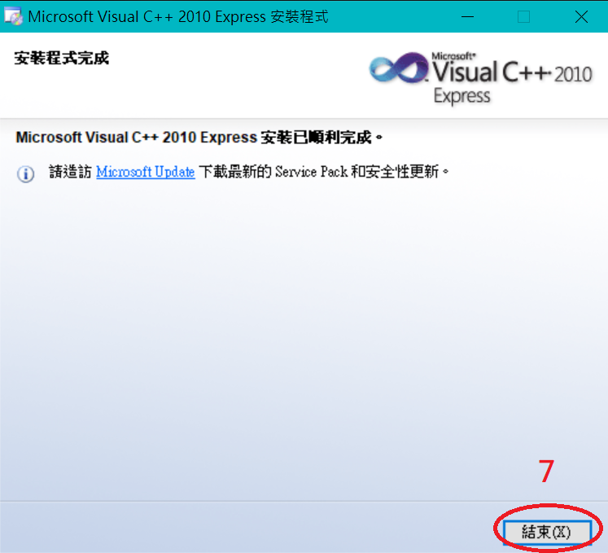

Slide 8
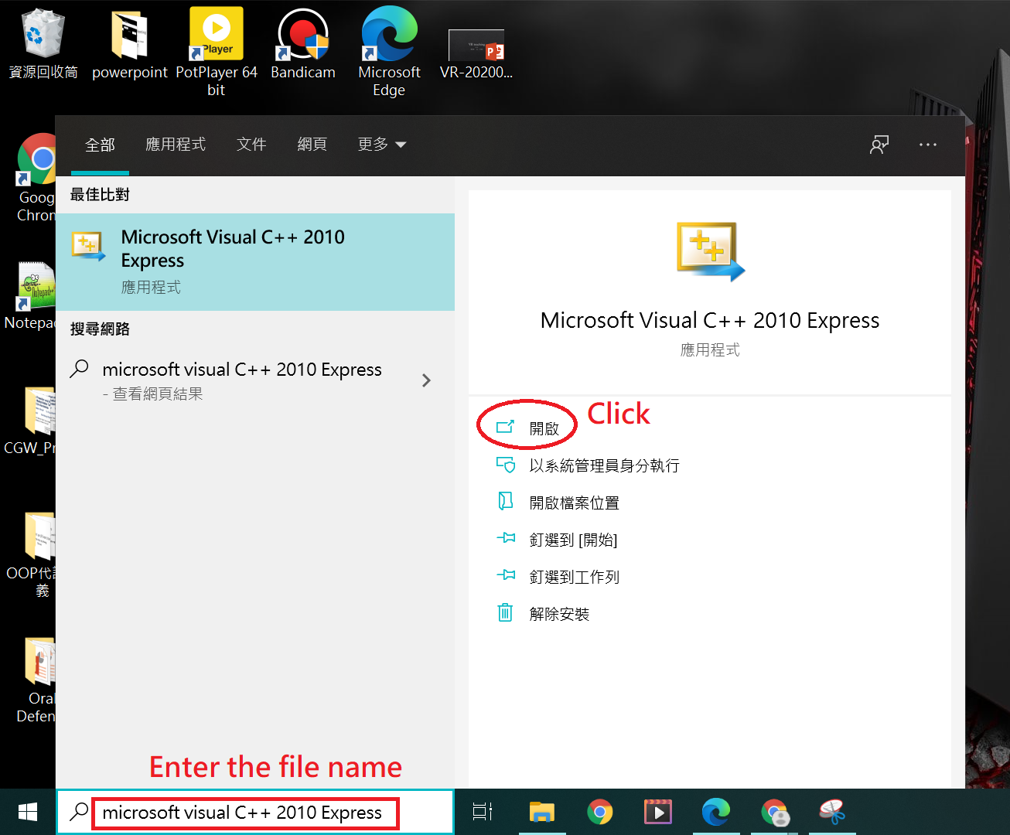
Open Visual Studio 2010

Slide 9
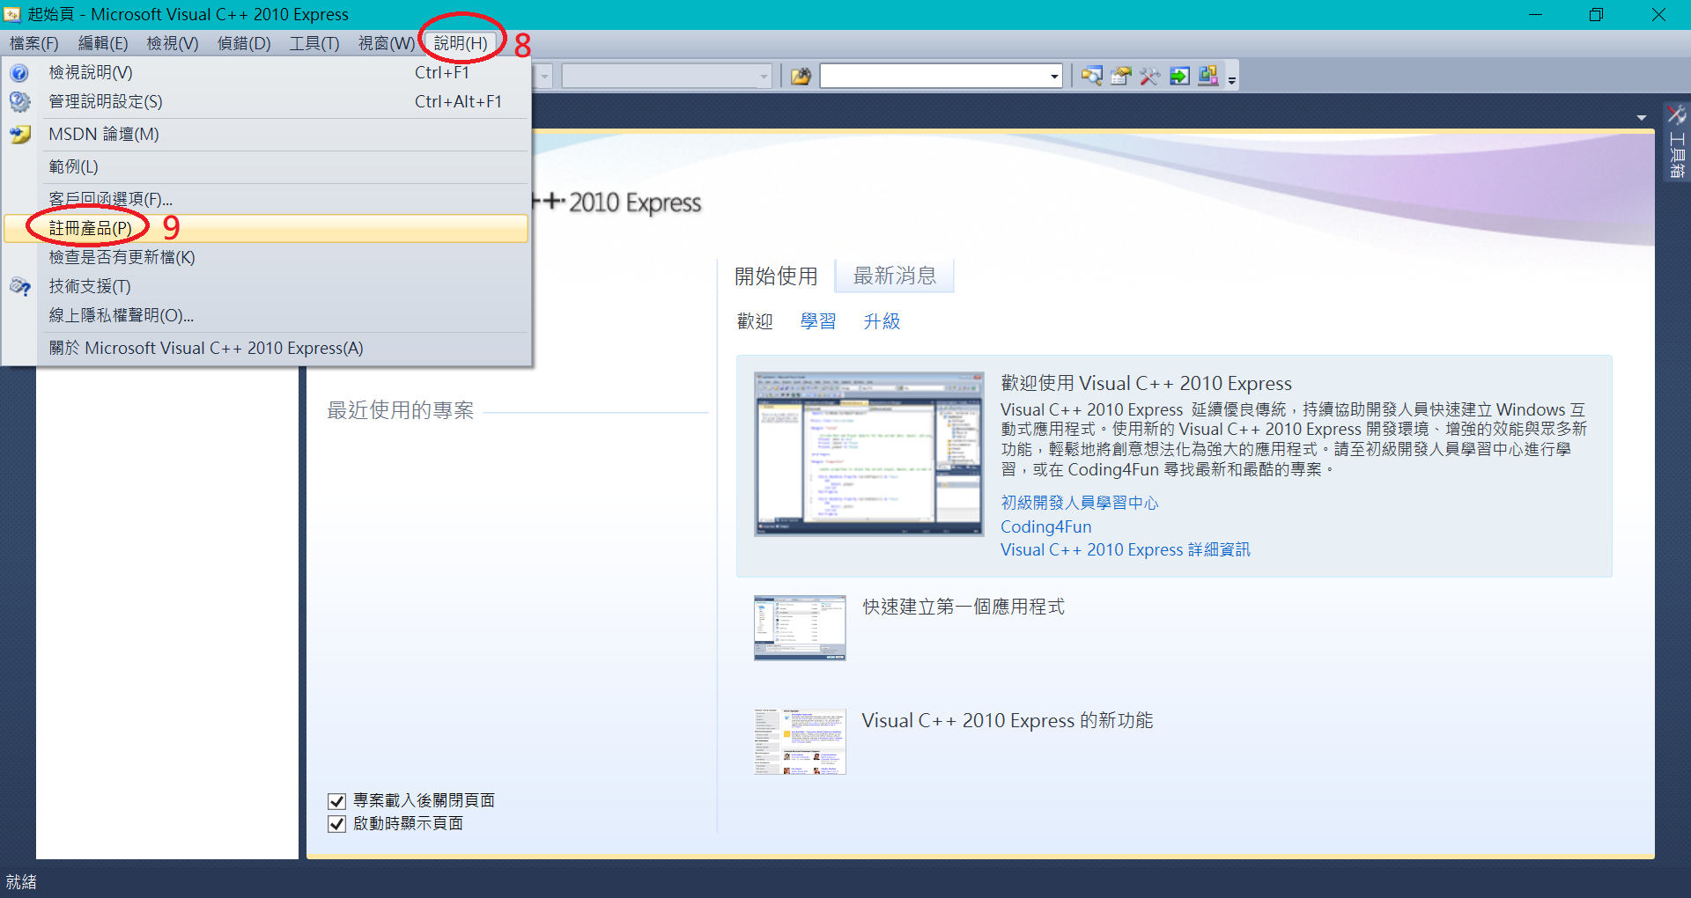

Slide 10
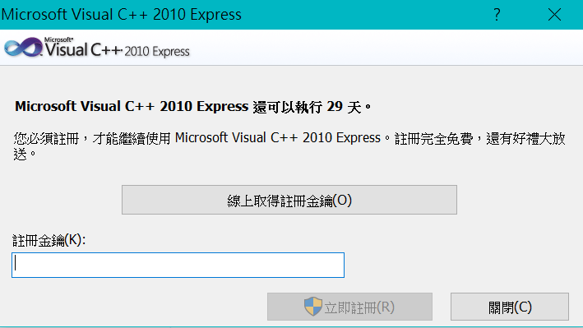
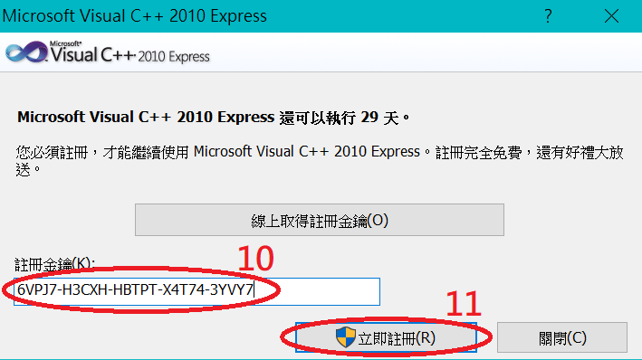
Enter the key:
6VPJ7-H3CXH-HBTPT-X4T74-3YVY7

Slide 11
Any question?

